Slide 1


HTML Foundation Framework: An Introduction
HTML Foundation is a popular and powerful front-end framework that provides a solid foundation for building responsive and accessible websites. It offers a comprehensive set of tools, components, and utilities to streamline web development.
by Riyaz Ahmed
ra

Slide 2
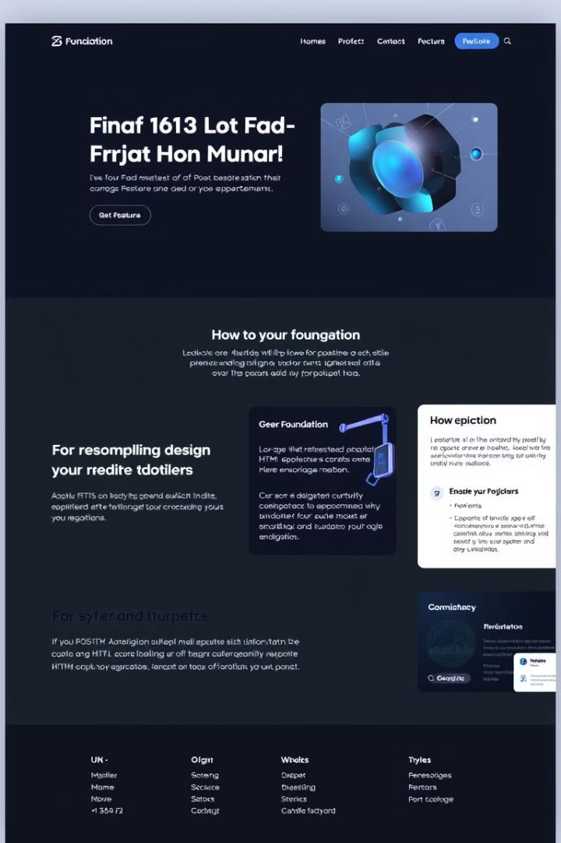
Understanding the Basics of HTML Foundation
1
Foundation Grid System
2
Foundation Components
Foundation provides a flexible grid system to organize content and create responsive layouts.
The framework offers a variety of pre-built components, such as buttons, forms, and navigation elements.
3
Foundation Utilities
HTML Foundation includes a set of utility classes to style elements quickly and efficiently.

Slide 3
Implementing the HTML Foundation Grid System
Columns
Rows
Nesting
Foundation's grid system is based on columns, which can be easily adjusted to create different layouts.
Columns are arranged within rows, providing a clear structure for page content.
Columns can be nested to create complex layouts and accommodate various screen sizes.

Slide 4
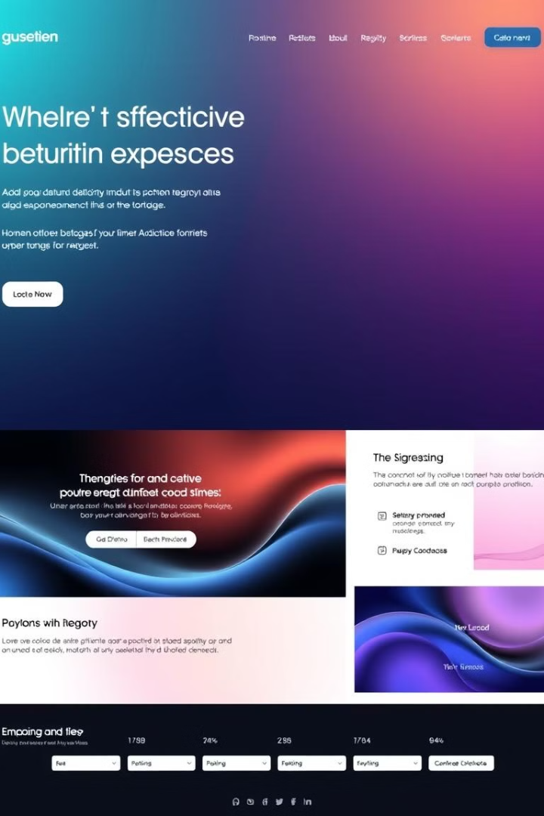



Setting Background Colors with HTML Foundation
Foundation Color Palette
The framework provides a curated color palette for consistent and harmonious color schemes.
Background Classes
Use the foundation-provided background classes to apply specific colors easily.
Custom Backgrounds
Override the default palette with custom colors to match your website's branding.

Slide 5
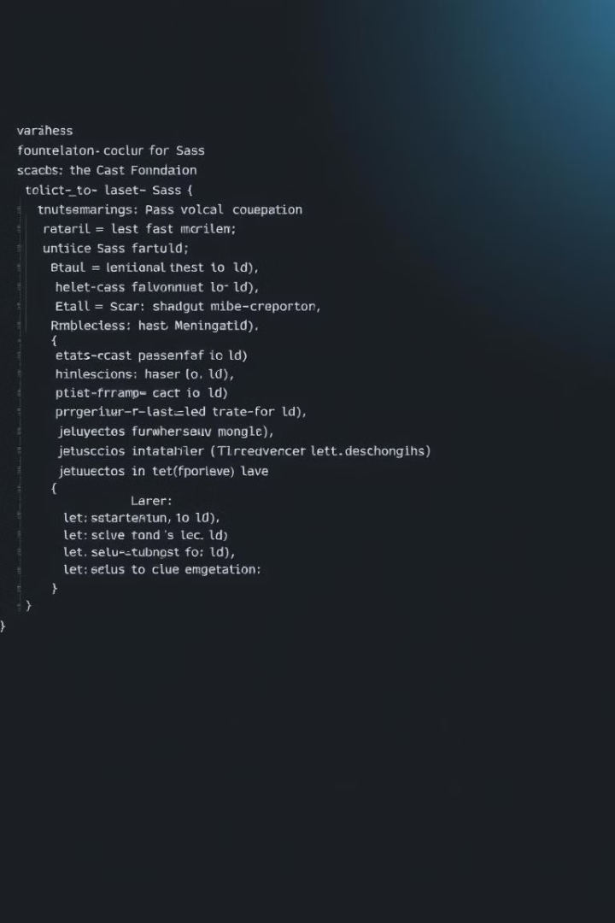
Customizing Colors using HTML Foundation Variables
Sass Variables
Variable Overrides
HTML Foundation uses Sass variables to define color values and allow for easy customization.
Modify the variable values in your Sass file to customize the default colors to match your brand.
Consistent Styling
By using variables, you ensure consistent color usage throughout your website.

Slide 6

Responsive Design with HTML Foundation
Media Queries
1
Foundation utilizes media queries to adjust layouts based on screen size.
Grid System Flexibility
2
The grid system adapts to different screen sizes, providing a consistent user experience.
Mobile-First Approach
3
Foundation promotes a mobile-first approach, ensuring optimal viewing on smaller screens.

Slide 7

Best Practices for HTML Foundation Implementation
Use semantic HTML
Follow coding standards
Minimize CSS overrides
Optimize for performance
Prioritize accessibility
Regularly update the framework

Slide 8
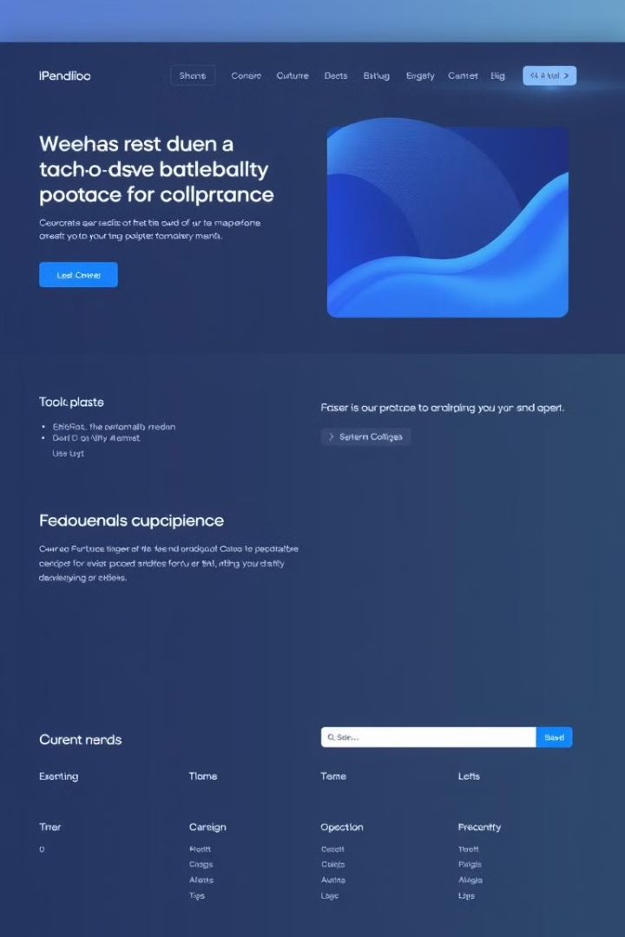



Conclusion and Key Takeaways
Speed and Efficiency
HTML Foundation streamlines web development and saves time and resources.
Responsive Layouts
The framework ensures that your website looks great on all devices.
Accessibility Features
Foundation promotes accessibility by providing built-in features and guidelines.

